Slide 1

Indian Premier League (IPL) Data Analysis using SQL

Slide 2
INTRODUCTION
The Indian Premier League (IPL) is a professional Twenty20 cricket league in India, established by the Board of Control for Cricket in India (BCCI) in 2008. Here’s a brief overview of its history:
Inception: The IPL was conceived following India’s victory in the inaugural T20 World Cup in 2007. The league was designed to combine cricket with entertainment, inspired by the success of the English Premier League (football) and the T20 format.
First Season: The inaugural season took place in 2008, with the Rajasthan Royals winning the first title..
Growth and Popularity: Over the years, the IPL has grown to include ten teams representing various cities across India. It has become one of the richest and most popular cricket leagues globally.

Slide 3


Slide 4

TEAMS

Slide 5
Objective
The objective of this project is to perform data analysis on IPL match data using SQL to uncover meaningful insights and patterns.

Slide 6
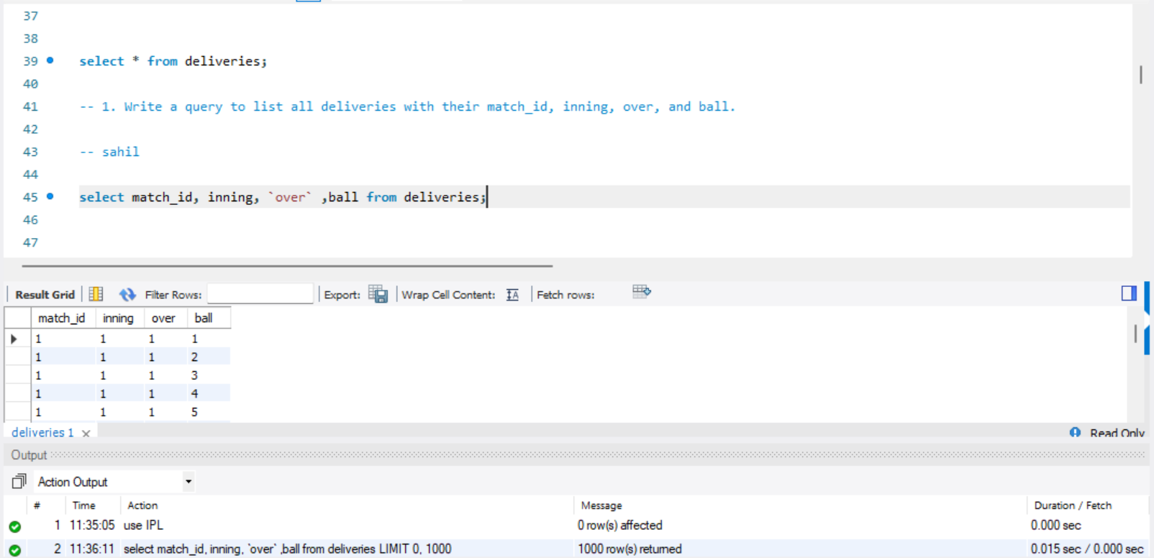

Write a query to list all deliveries with their match_id, inning, over, and ball.

Slide 7
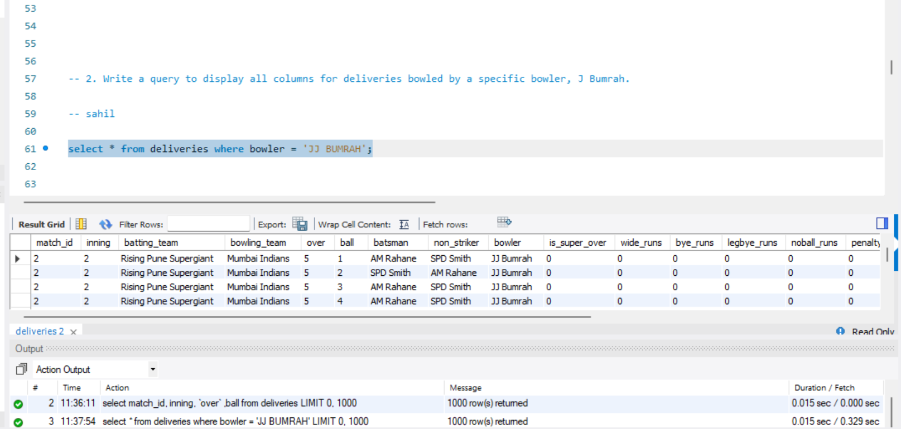

Write a query to display all columns for deliveries bowled by a specific bowler, J Bumrah.

Slide 8
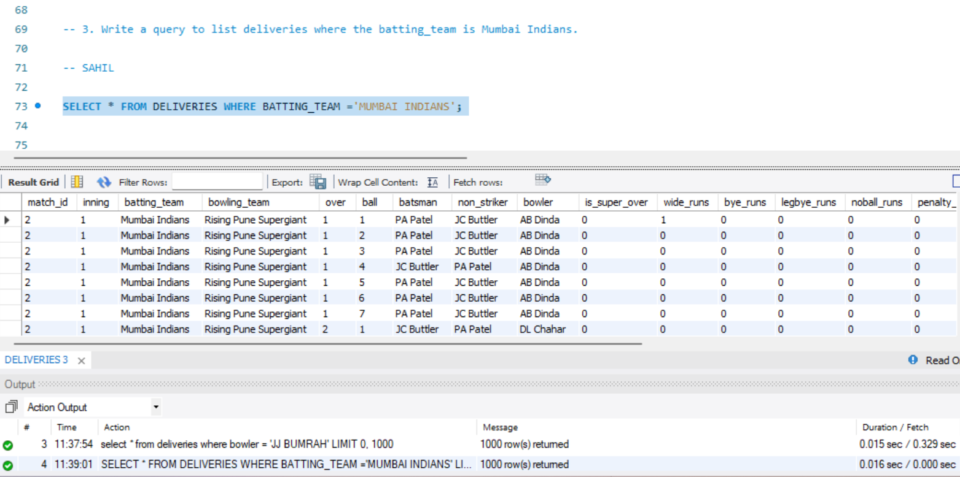

Write a query to list deliveries where the batting_team is Mumbai Indians.

Slide 9
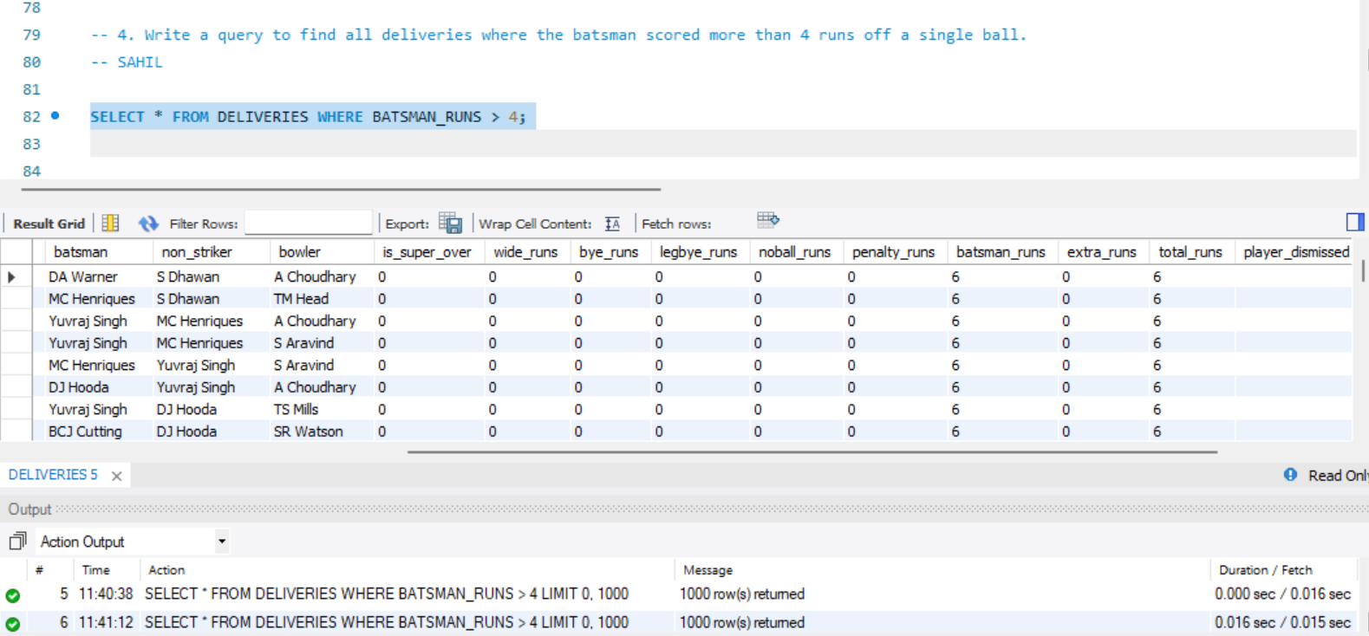
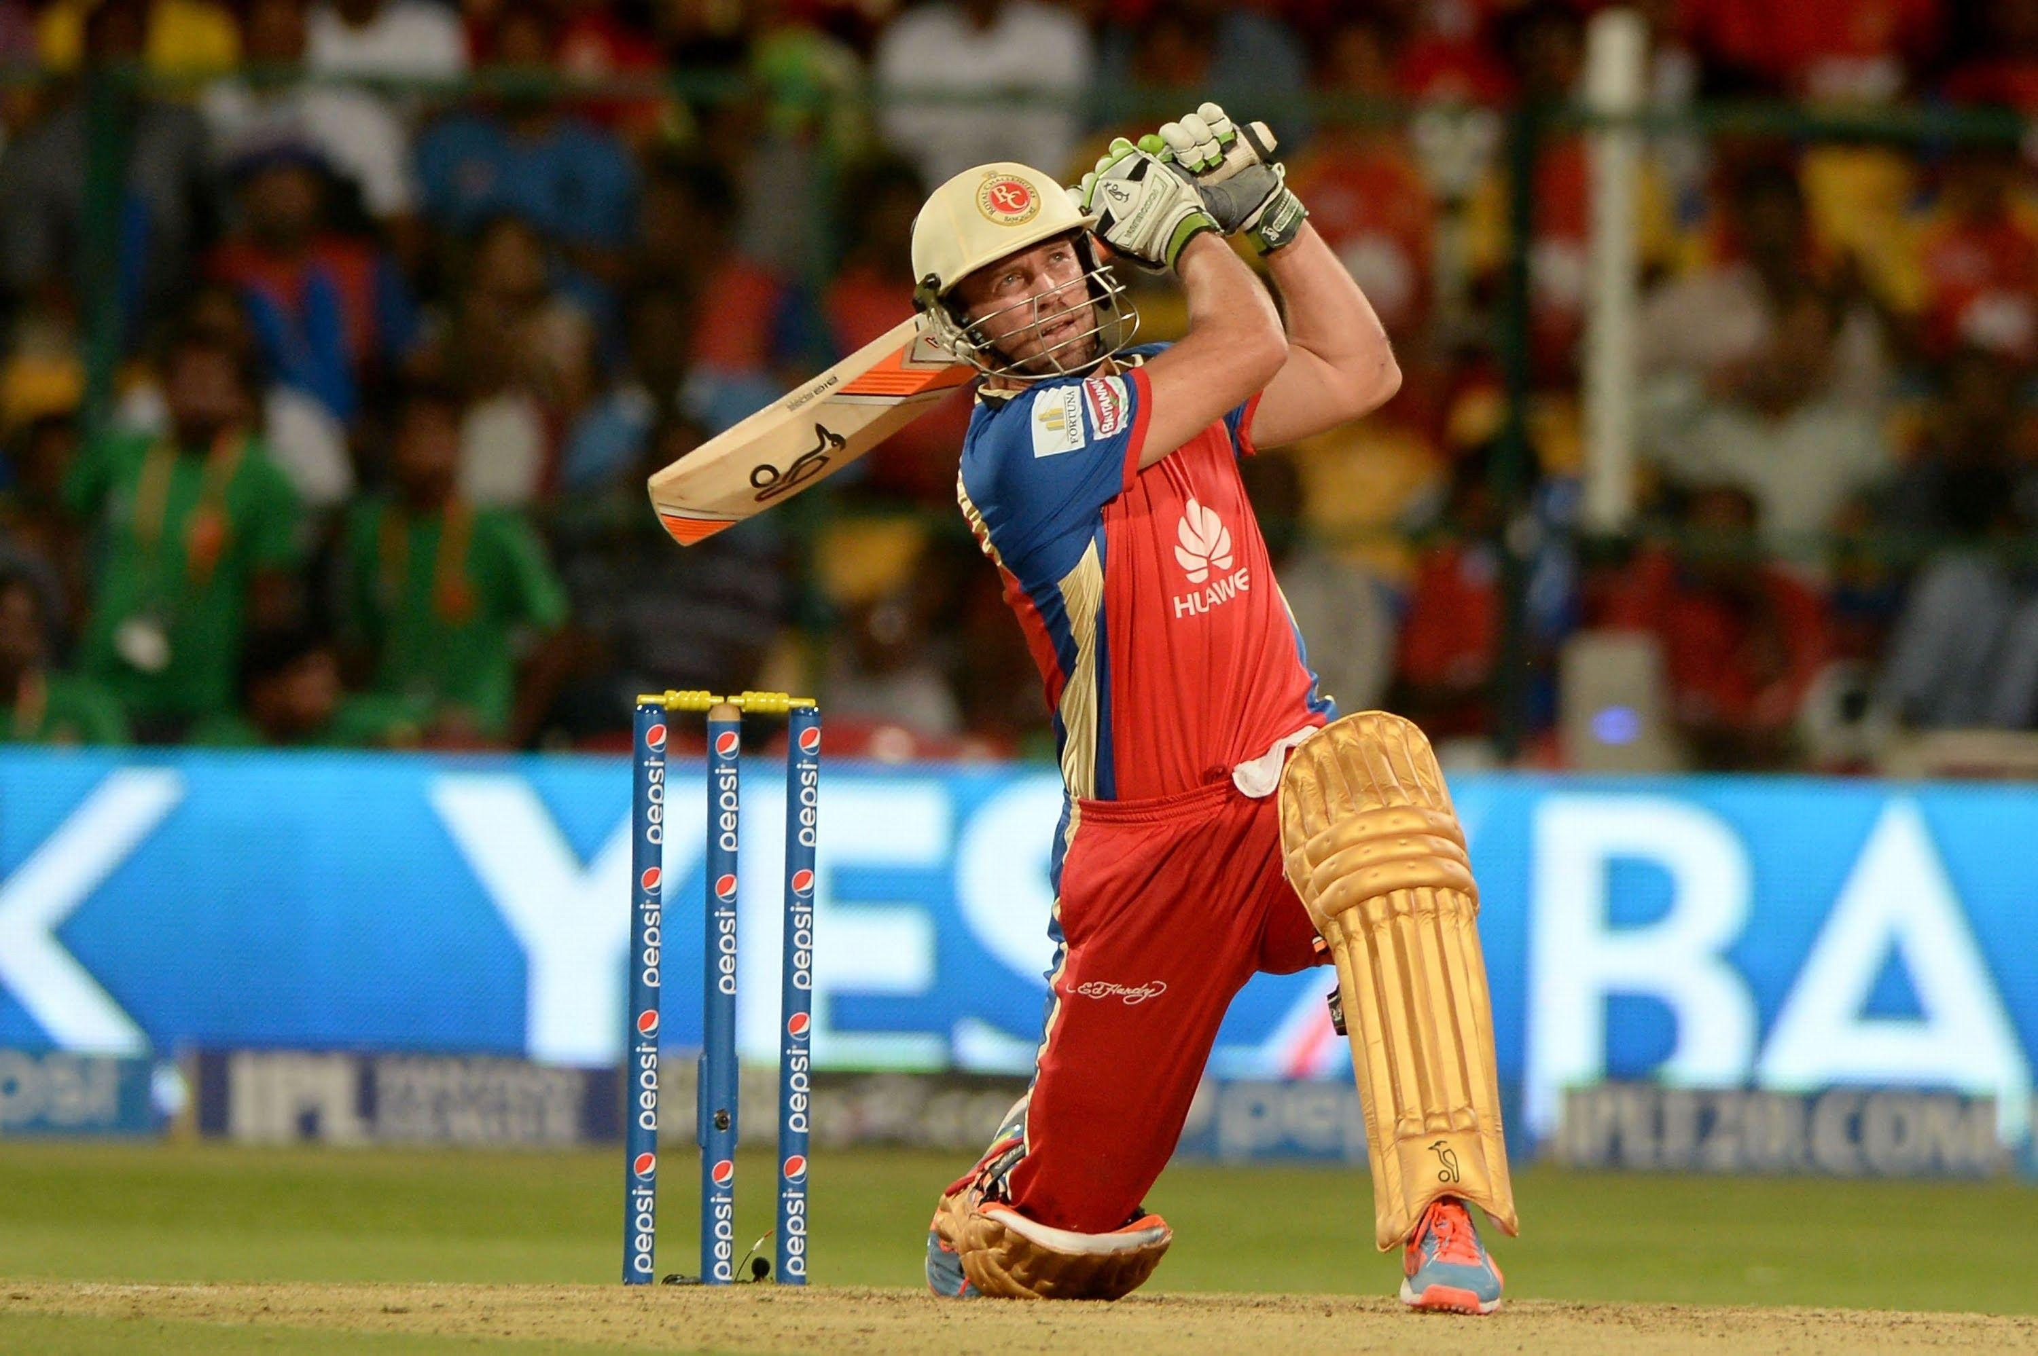
Write a query to find all deliveries where the batsman scored more than 4 runs off a single ball.

Slide 10
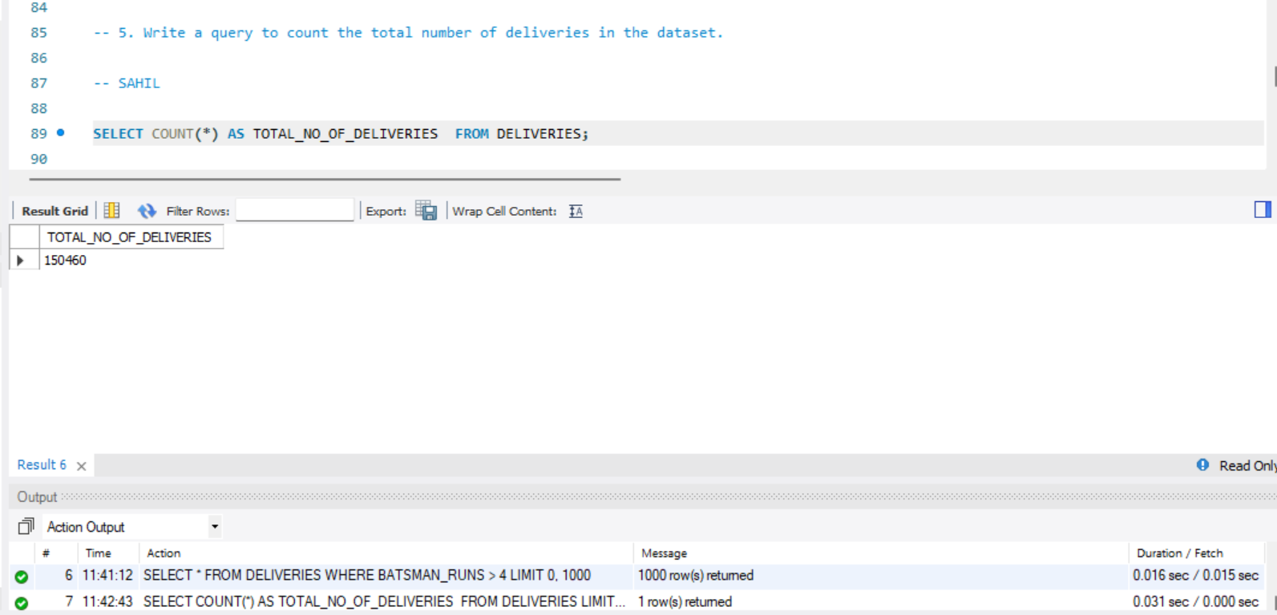
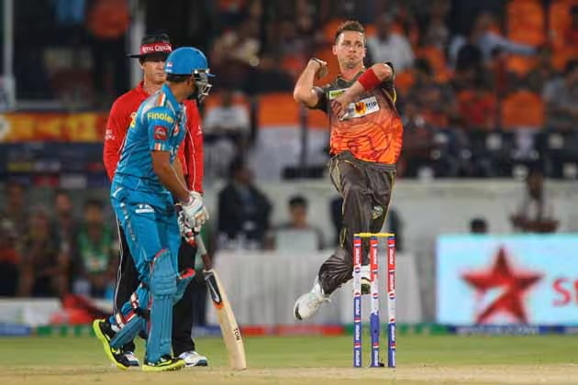
Write a query to count the total number of deliveries in the dataset.

Slide 11
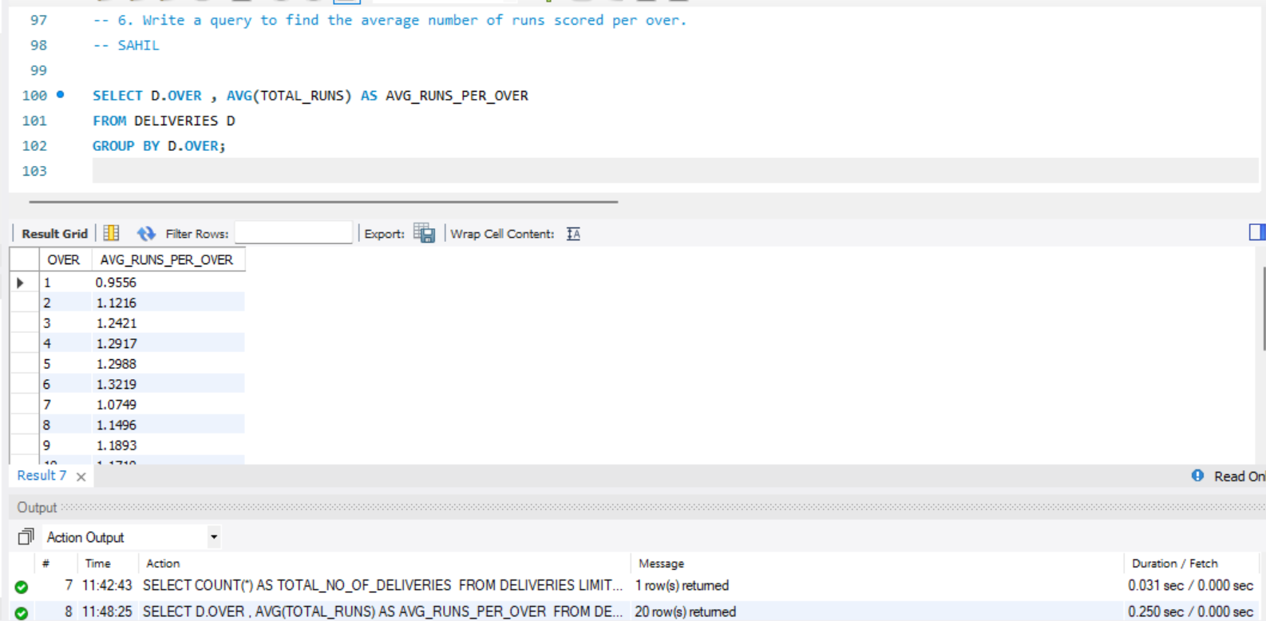
Write a query to find the average number of runs scored per over.

Slide 12
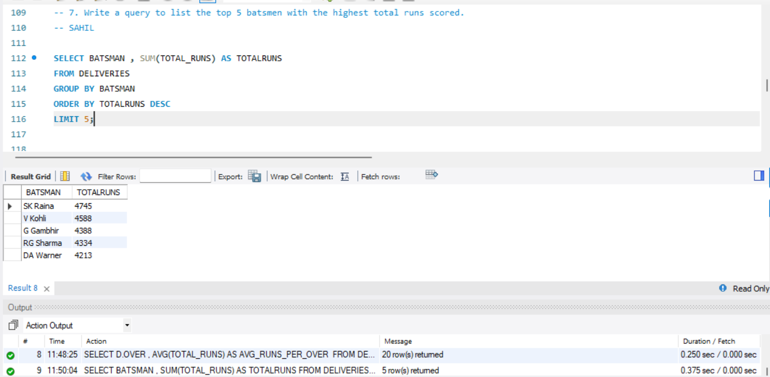
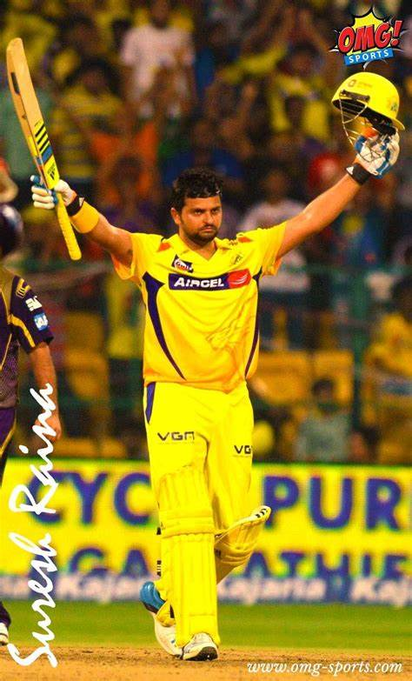
Write a query to list the top 5 batsmen with the highest total runs scored.

Slide 13
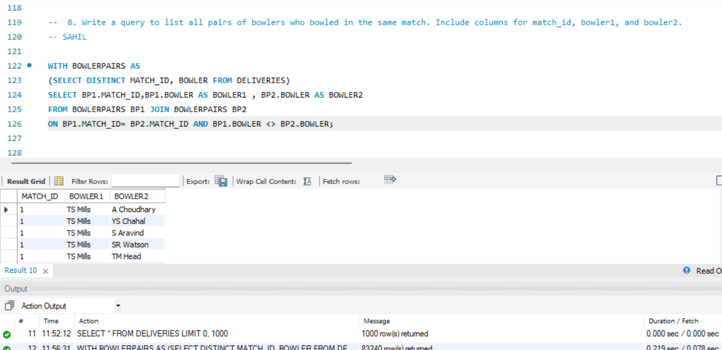
Write a query to list all pairs of bowlers who bowled in the same match. Include columns for match_id, bowler1, and bowler2.

Slide 14
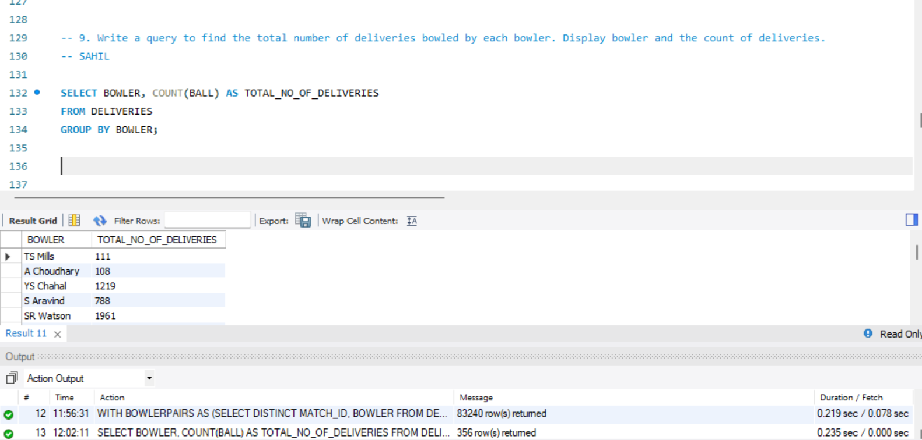
Write a query to find the total number of deliveries bowled by each bowler. Display bowler and the count of deliveries.

Slide 15
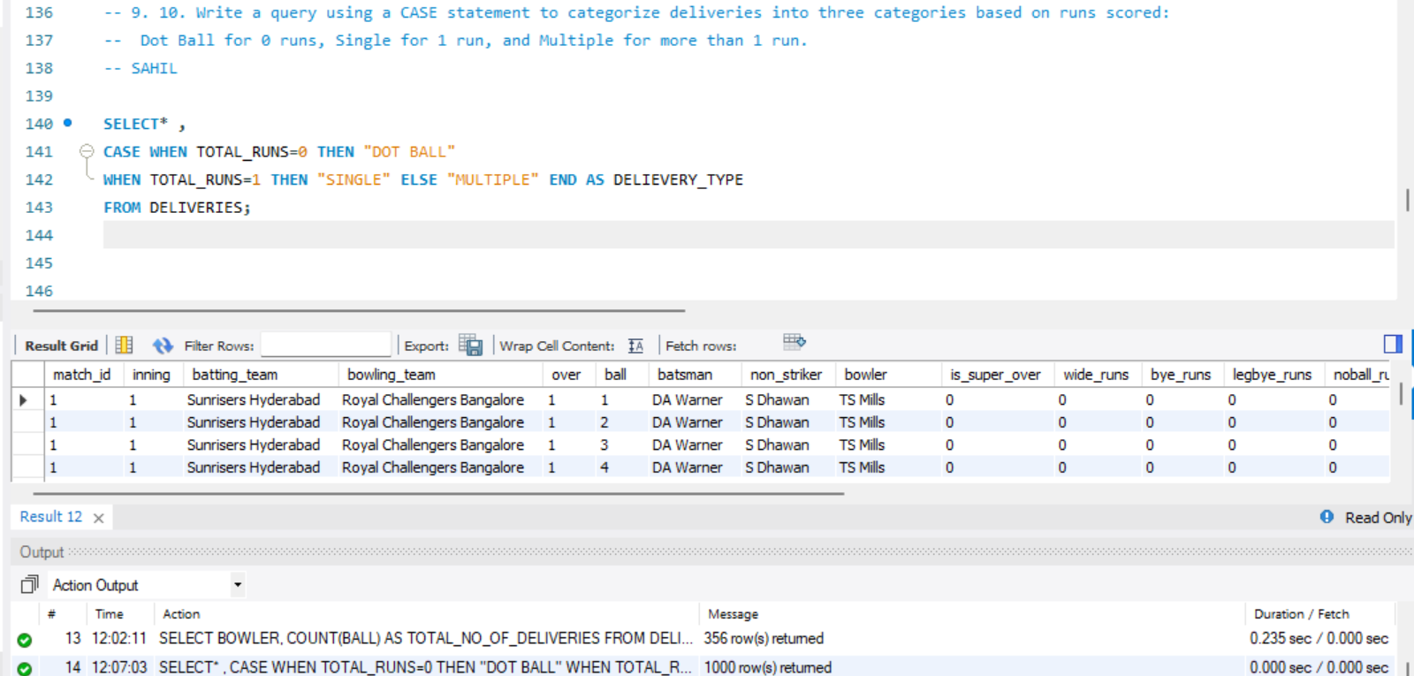
. Write a query using a CASE statement to categorize deliveries into three categories based on runs scored: Dot Ball for 0 runs, Single for 1 run, and Multiple for more than 1 run.

Slide 16
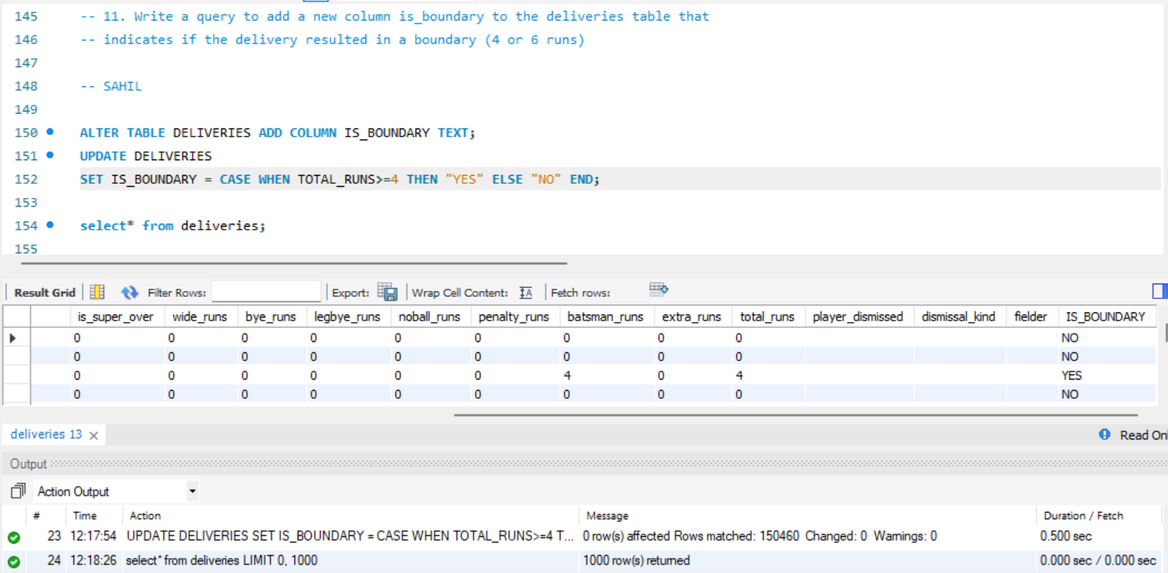
Write a query to add a new column is_boundary to the deliveries table that indicates if the delivery resulted in a boundary (4 or 6 runs).

Slide 17
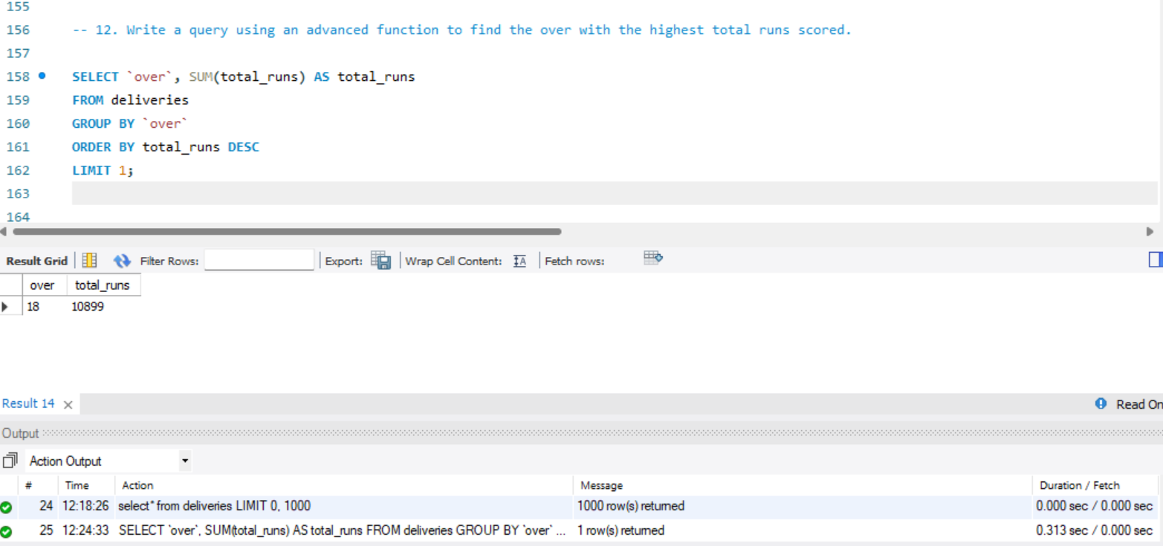
Write a query using an advanced function to find the over with the highest total runs scored.

Slide 18
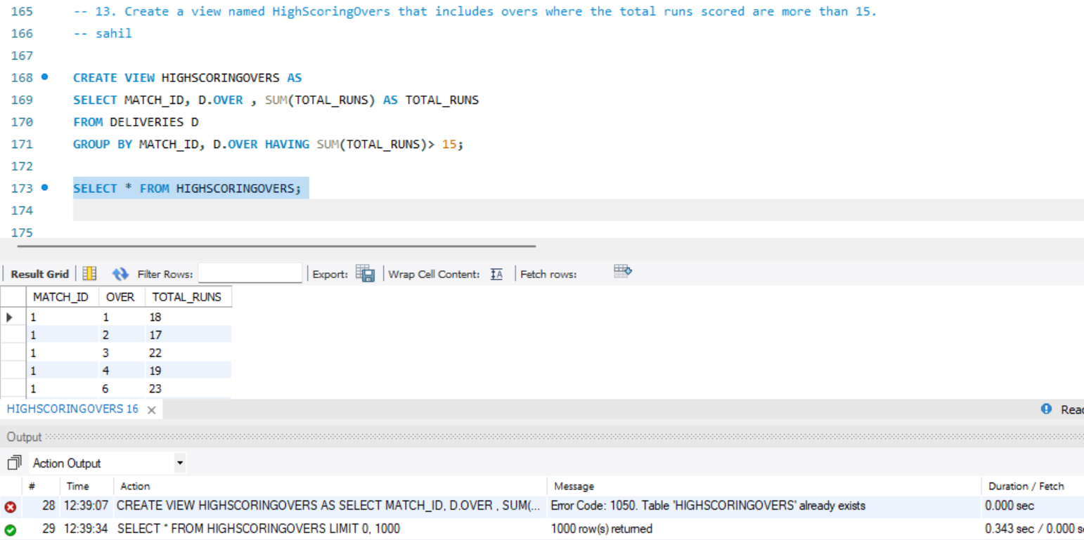
Create a view named HighScoringOvers that includes overs where the total runs scored are more than 15.

Slide 19
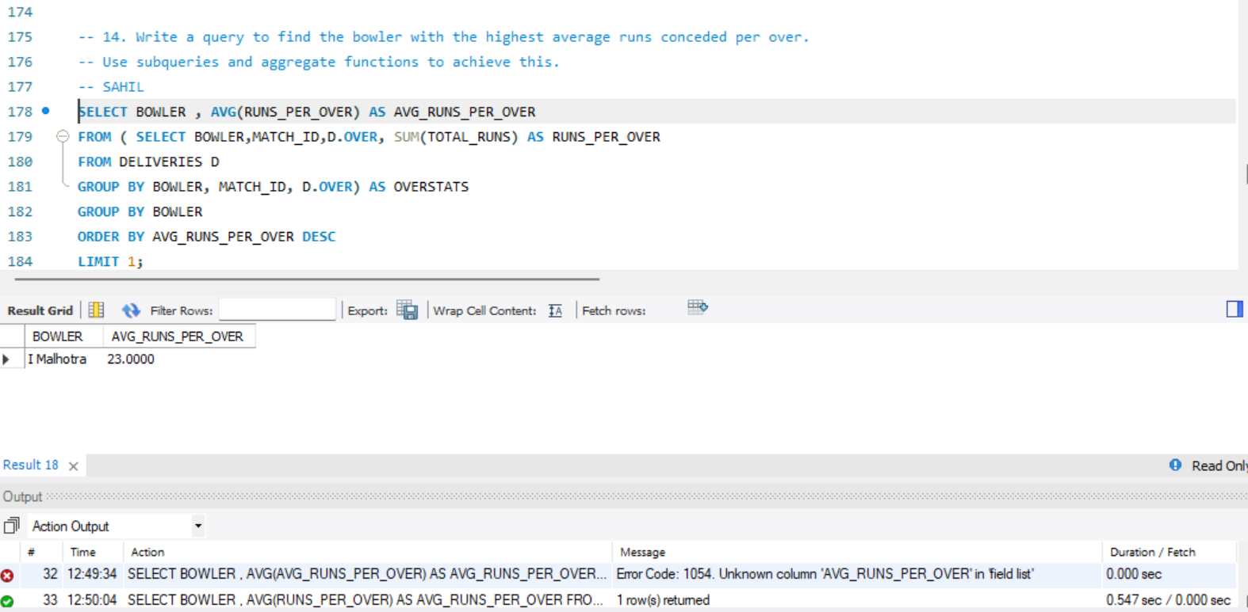

Write a query to find the bowler with the highest average runs conceded per over. Use subqueries and aggregate functions to achieve this.

Slide 20
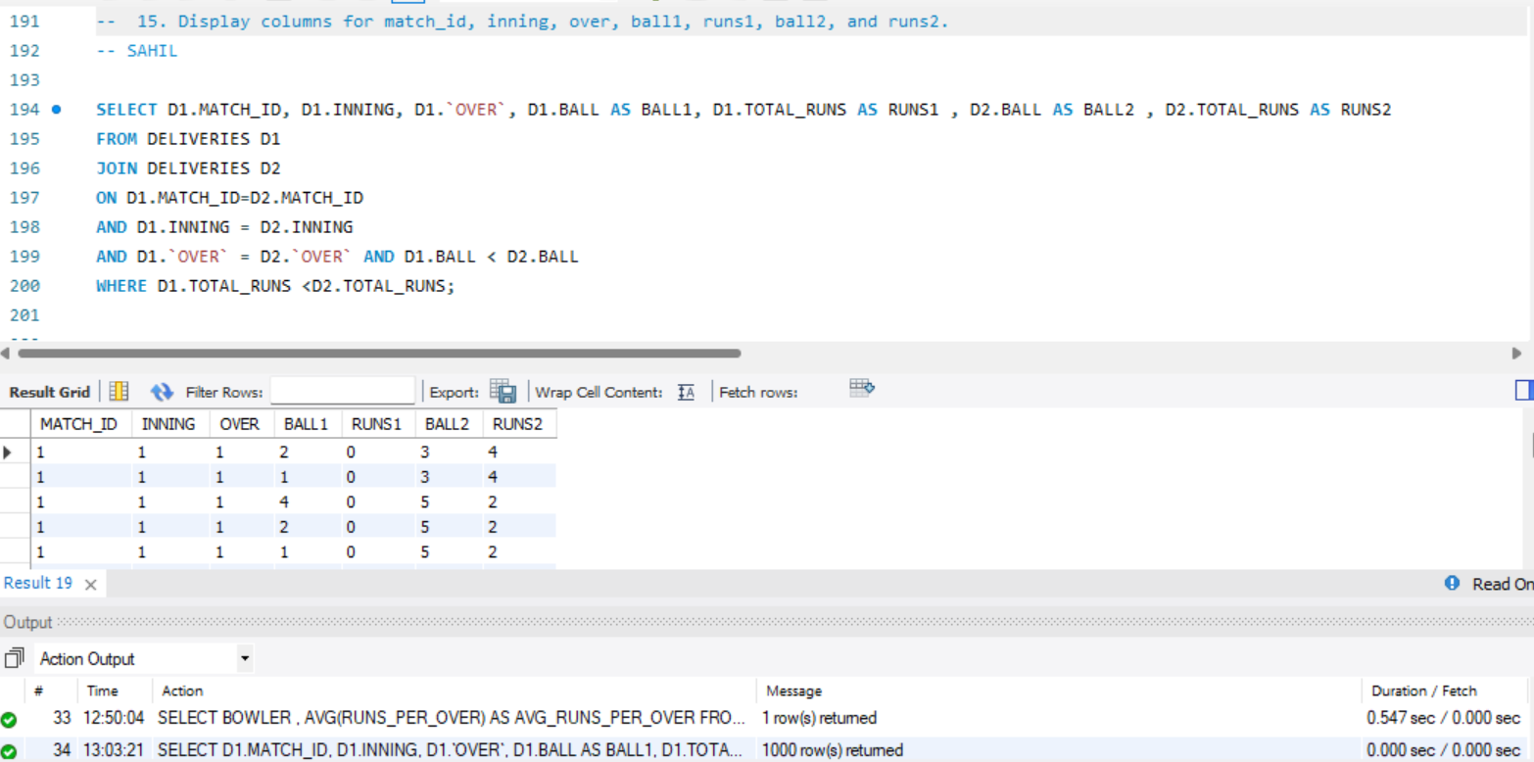
Write a query to find pairs of deliveries in the same over where one delivery resulted in more runs than the other. Display columns for match_id, inning, over, ball1, runs1, ball2, and runs2.

Slide 21
Conclusion
. The conclusion of this project highlights the successful application of SQL in Analyzing the IPL match data.
. The analysis provided insights into player performances team statistics , and overall match trends.
. The project demonstrated the power of data analysis in uncovering patterns and supporting
Data driven decision making in sports.

Slide 22


